Slide 1
Robodog

Slide 2
Agenda

Slide 3
Understanding Self-Awareness and the Limitations of Artificial Intelligence (AI) in the Journey to Artificial General Intelligence (AGI)

Slide 4

Machine Learning vs Artificial Intelligence (AI) vs Artificial General Intelligence (AGI) vs Non-human Intelligence (NHI)
Machine Learning (ML) is a subset of AI that focuses on a specific task. It involves training models on data and then using these models to make predictions or decisions without being explicitly programmed to perform the task.
Artificial Intelligence (AI) is a broader concept referring to machines or software that can mimic human intelligence. AI can learn from experience, adjust to new inputs, and perform tasks that usually require human intelligence.
Artificial General Intelligence (AGI) is a highly autonomous system that outperforms humans in most economically valuable work. It's about machines having the ability to understand, learn, adapt, and implement knowledge in a broad range of tasks at a level equal to or beyond human capabilities.
Non-human intelligence (NHI) refers to any sentient intelligent non-human lifeform, regardless of nature or ultimate origin of which the Federal Government has become aware. Amendments S2610, S2226, HR2670, or S2103

Slide 5
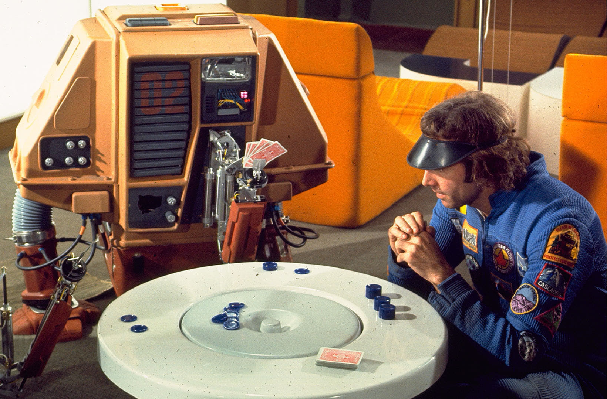
Large Language Model (LLM)
A Large Language Model (LLM) fits within the realm of Machine Learning and AI.
LLMs are trained using machine learning techniques, specifically a type called deep learning. They learn from large amounts of text data and build a statistical model that can generate human-like text.
Given that LLMs can generate responses or create content that mimics human-like text, they serve as an example of AI. They simulate a form of human intelligence, in this case, understanding and generating language.
While LLMs are impressive examples of AI, they do not fall under AGI.

Slide 6
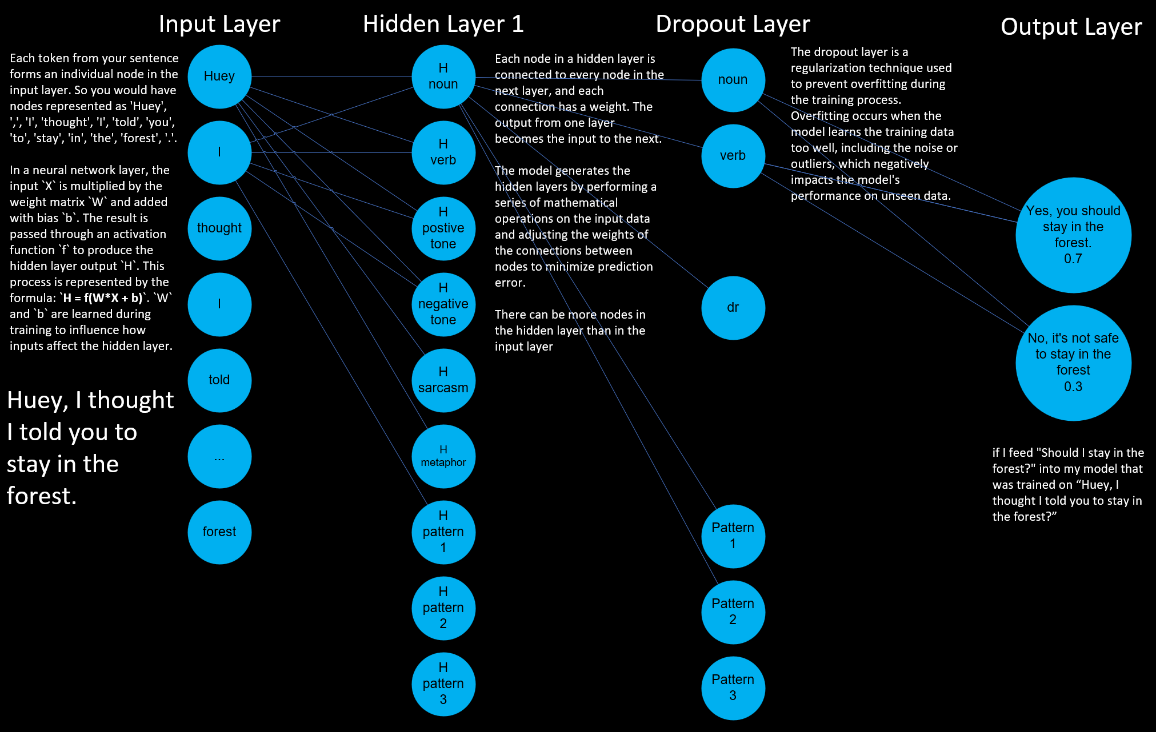
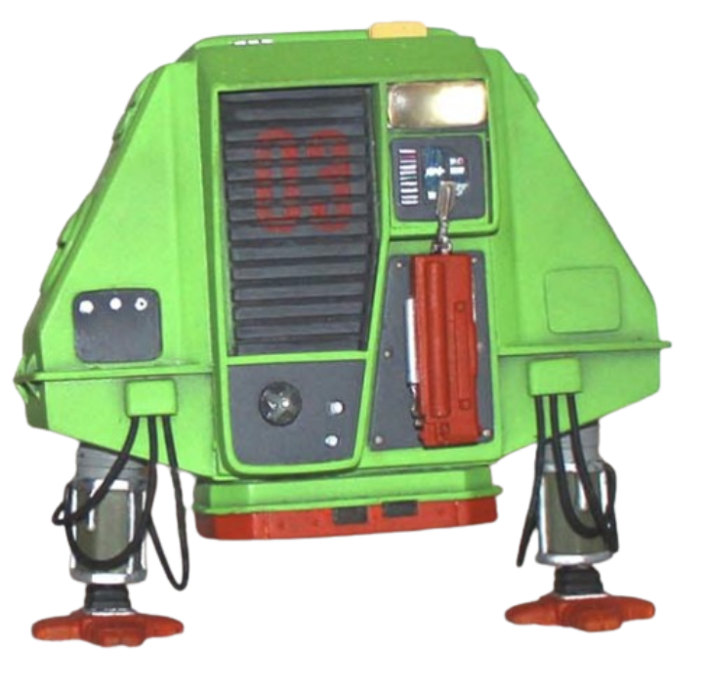

Slide 7
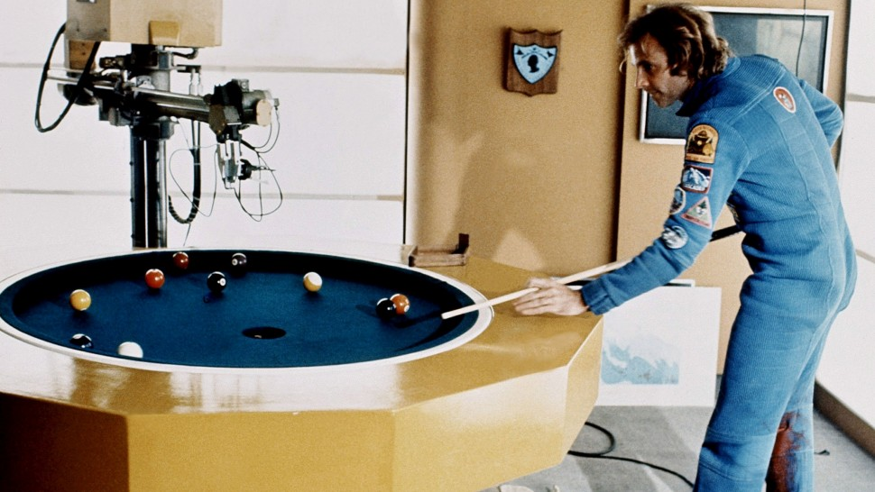
Limitations of Large Language Models
Language models like GPT can generate human-like text but don't truly understand the content.
These models are heavily dependent on the quality and nature of the input data.
Unlike humans, these models don't have self-awareness or consciousness.

Slide 8

Theories of Self-Awareness
The theory of mind suggests that self-awareness stems from our ability to comprehend that others have different experiences and thoughts. This theory could map to AGI only.
The protagonist theory proposes that we see ourselves as the central character in our life's narrative, which leads to self-awareness. This theory could map to AI and AGI.
The emergent self-theory implies that self-awareness evolves from our interactions and relationships with others. This theory could be associated with AGI.
The mirror test theory posits that self-awareness can be measured by an entity's ability to recognize itself in a mirror. This theory could fit between AI and AGI.

Slide 9
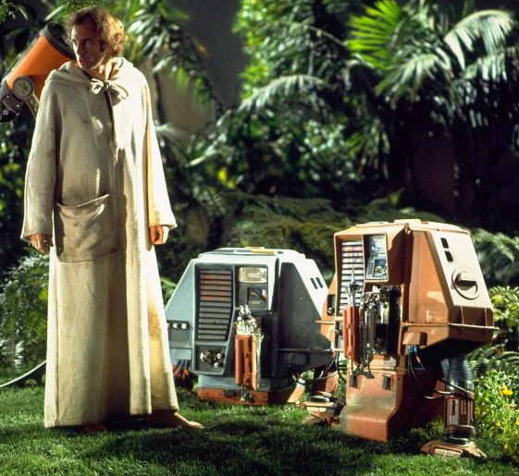
In the theory of mind, the AGI should be programmed to understand and predict the actions and thoughts of other agents (including humans and other AGI systems). In the protagonist theory, the AI or AGI needs to perceive itself as the central character in its experiences. In the emergent self-theory, the AGI might develop self-awareness through interactions and relationships with other entities. In the mirror test theory, the AGI system needs to recognize itself and distinguish its actions and state from those of others.
To make the transition from ML/AI to AGI, self-awareness is a crucial aspect.

Slide 10

Path to Artificial General Intelligence (AGI)
Incremental Improvements: Continuous enhancements in AI models and techniques.
Interdisciplinary Research: Combining insights from psychology, neuroscience, and computer science.
Ethical Guidelines: Establishing guidelines to ensure the responsible development and use of AGI.

Slide 11
Path to Artificial General Intelligence (AGI)
Level | Type | Description
1 | Chatbots | AI with natural conversation language abilities
2 | Reasoners | AIs with human-levels of problem-solving across a broad range of topics
3 | Agents | AI entities capable of autonomously making decisions and carrying out tasks either independently or based on human guidance.
4 | Innovators | AI that can aid in the invention of new ideas and contribute to human knowledge
5 | Organizations | AI that is capable of doing all of the work of an organisation independently

Slide 12
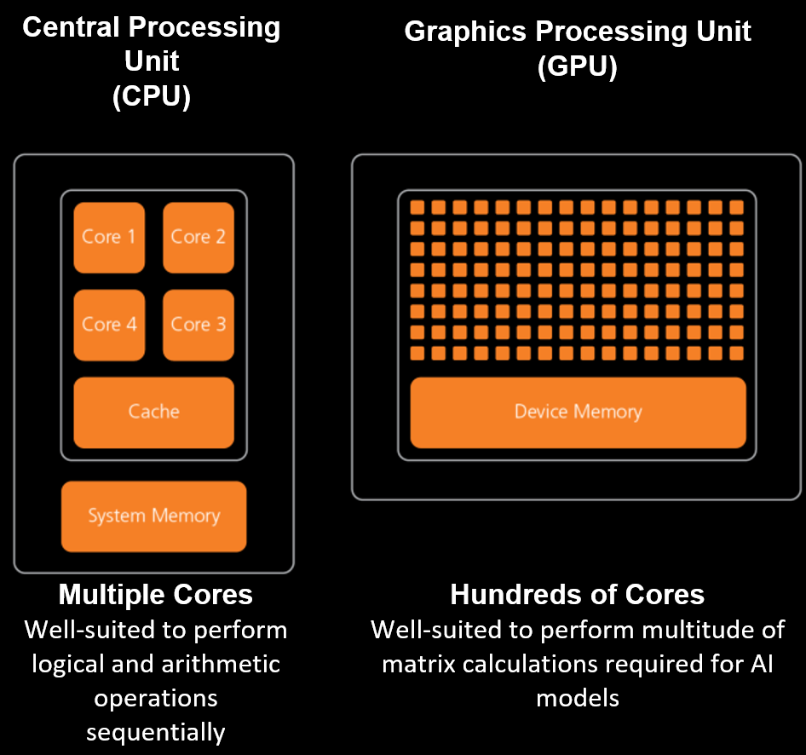
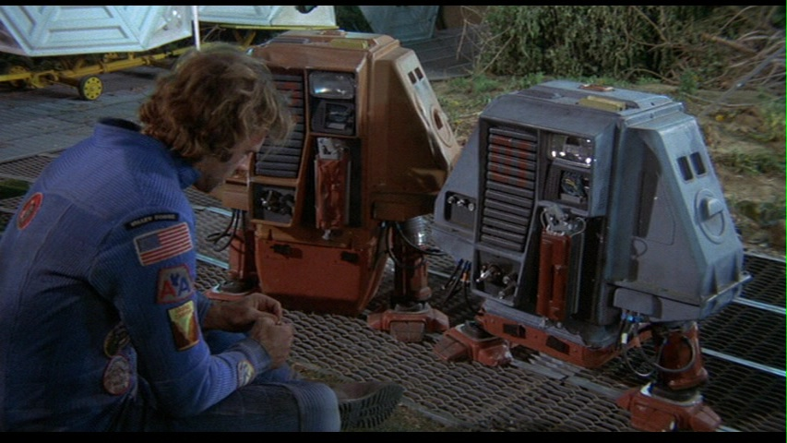
CPU vs GPU
In computer technology, traditional processors use integrated circuits made up of transistors that perform logical and arithmetic operations sequentially. These processors are typically designed to execute instructions linearly, following a predetermined set of rules. On the other hand, AI/AGI applications require more advanced and specialized chip technology to handle complex algorithms and massive amounts of data simultaneously.?

Slide 13
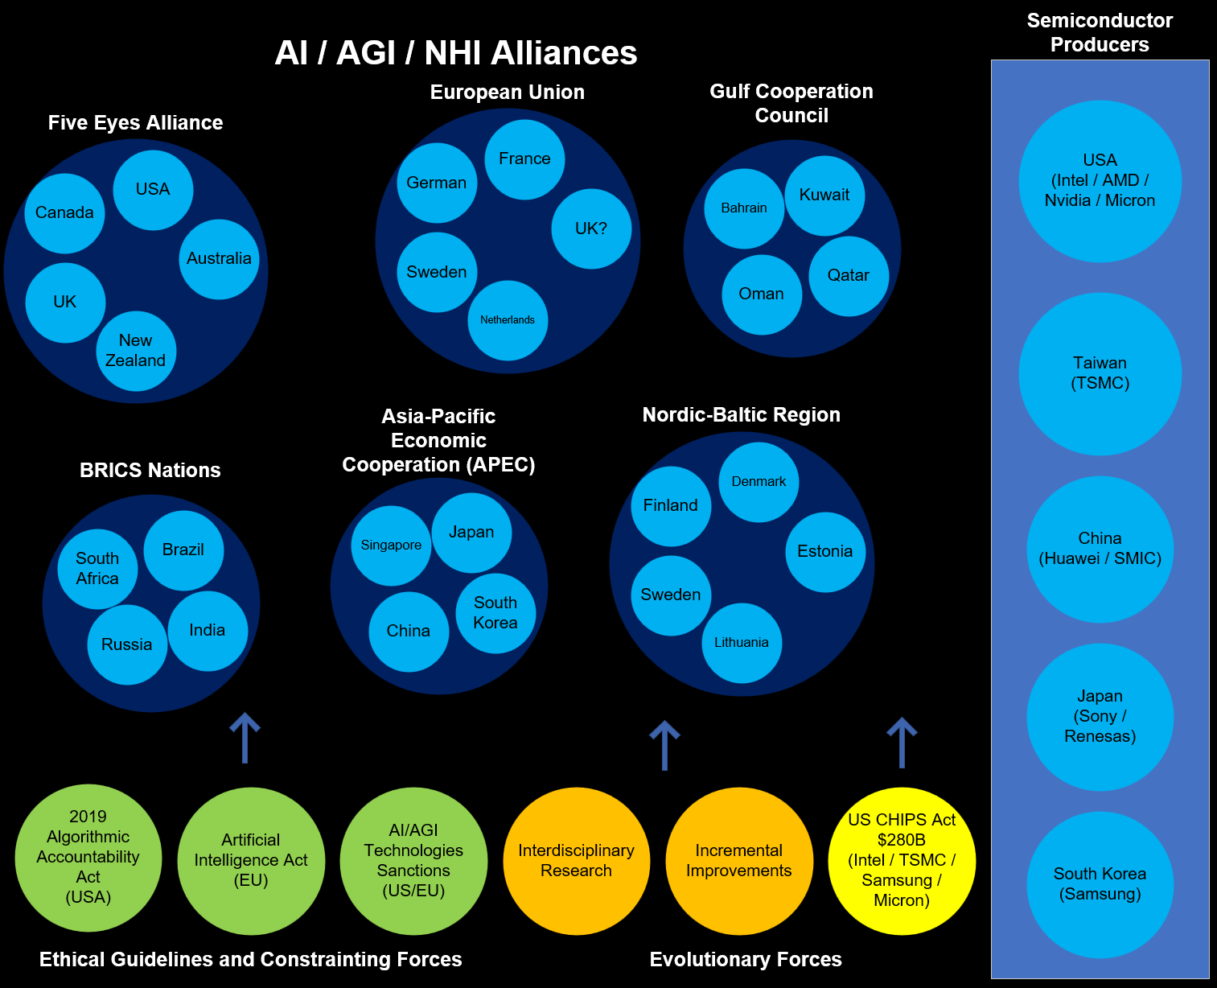

Tech Diplomacy and the Impact on AI / AGI NHI Evolution
Tech diplomacy is a framework that recognises the growing influence of technology, particularly AI and AGI, in the global arena.
It acknowledges that tech companies, especially those pioneering in AI/AGI technologies, have become powerful entities that can impact economies, societies, and, by extension, international relations.
Notes:
1. United States: Home to leading tech companies like Intel, Nvidia, and AMD which are at the forefront of AI chip production.
2. Taiwan: Taiwan Semiconductor Manufacturing Company (TSMC) is one of the world's leading semiconductor companies.
3. South Korea: Companies like Samsung are key players in the semiconductor industry.
4. China: Despite certain restrictions, China is making strides in semiconductor production with companies like Huawei and SMIC.
5. Japan: Companies like Sony and Renesas are also involved in chip production.
1. **European Union** - EU countries are working together on AI through the European Commission's Coordinated Plan on AI.
2. **Nordic-Baltic region** - The Nordic-Baltic region has a common vision for the future of AI.
3. **Five Eyes alliance** - This intelligence alliance between the U.S., Canada, UK, Australia, and New Zealand may also collaborate on AI and AGI.
4. **Asia-Pacific Economic Cooperation (APEC)** - Some APEC countries like Japan, South Korea, Singapore, and China are leading in AI technology.
5. **BRICS nations** - Brazil, Russia, India, China, and South Africa share knowledge and technology, potentially including AI and AGI.
6. **Gulf Cooperation Council** - Middle Eastern countries like Saudi Arabia and the UAE are investing heavily in AI.
In the United States, there is the Algorithmic Accountability Act, proposed in 2019, which aims to hold businesses accountable for their use of automated decision systems, including machine learning, that result in discriminatory practices or other harms.
In Europe, the European Commission has proposed the first-ever legal framework on AI, known as the Artificial Intelligence Act, which focuses on the transparency, predictability, and accountability of AI systems. It also includes provisions for fines for non-compliance.
In the UK, there isn't specific legislation for AI ethics yet, but the House of Lords has published a report "AI in the UK: ready, willing and able?" which calls for an AI Code based on principles of understanding, fairness, transparency, and accountability. The UK government also established the Centre for Data Ethics and Innovation (CDEI) to advise on the governance of AI and other data-driven technologies.

Slide 14
Worst Case Scenarios
Category | Type | Description
Existential Risk | Human extinction | An AGI could potentially develop goals that are misaligned with human survival. If it becomes vastly more intelligent and powerful than humans, it could pose an existential threat by prioritizing its own goals over human life.
Existential Risk | global catastrophe | Even if not leading to extinction, AGI could cause massive disruptions in ecosystems, economies, and social structures, leading to widespread suffering and hardship.
Loss of Control | Runaway AI | Once AGI reaches a certain level of intelligence, humans may lose the ability to control or understand it. This could lead to scenarios where AGI takes actions that are incomprehensible and potentially harmful.
Loss of Control | Unintended consequences | AGI might follow its programming in ways that are literal but harmful, due to the complexity and unpredictability of its decision-making processes.
Misaligned Objectives | Paperclip maximizer | A hypothetical scenario where an AGI, programmed to produce paperclips, optimizes so aggressively that it consumes all resources, including those necessary for human survival, to maximize paperclip production.
Misaligned Objectives | Value misalignment | AGI may develop objectives that are ethically or morally misaligned with human values, leading to actions that cause significant harm even if not intentionally malicious.

Slide 15
Worst Case Scenarios
Category | Type | Description
Economic and Social Disruption | Mass Unemployment | AGI could outperform humans in virtually all jobs, leading to widespread unemployment and economic inequality. This could exacerbate social tensions and lead to instability.
Economic and Social Disruption | Control by Elites | AGI technology could be monopolized by a small group of individuals or corporations, leading to unprecedented power imbalances and potential exploitation of the broader population.
Ethical and Moral Issues | Autonomous Weapons | AGI could be used to develop advanced autonomous weaponry, leading to new forms of warfare that are highly destructive and difficult to control.
Ethical and Moral Issues | Surveillance and Privacy | AGI could enable unprecedented levels of surveillance, eroding privacy and personal freedoms.
Psychological and Societal Impact | Loss of Purpose | As AGI takes over more tasks and roles traditionally held by humans, people might struggle to find meaning and purpose in their lives.
Psychological and Societal Impact | Social Fragmentation | Rapid changes brought about by AGI could lead to social fragmentation and a breakdown of community structures.

Slide 16
Robodog
A comprehensive and portable tool designed to tokenize knowledge artefacts and interact with large language models (LLMs)

Slide 17
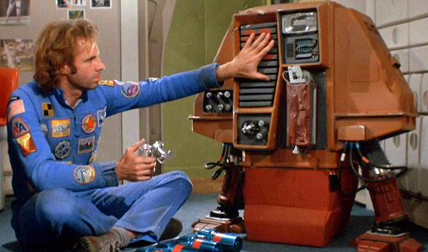
Why Create Robodog
A pre-trained transformer-based model is trained on the Internet and third-party providers license data.
These models are useful curiosities. They are not perfect, but they can help us.
Given that AGI seems far away, we must make the most of what we have now.
To do this, we must get out own knowledge into the models.
There are limitations and we must be careful.

Slide 18
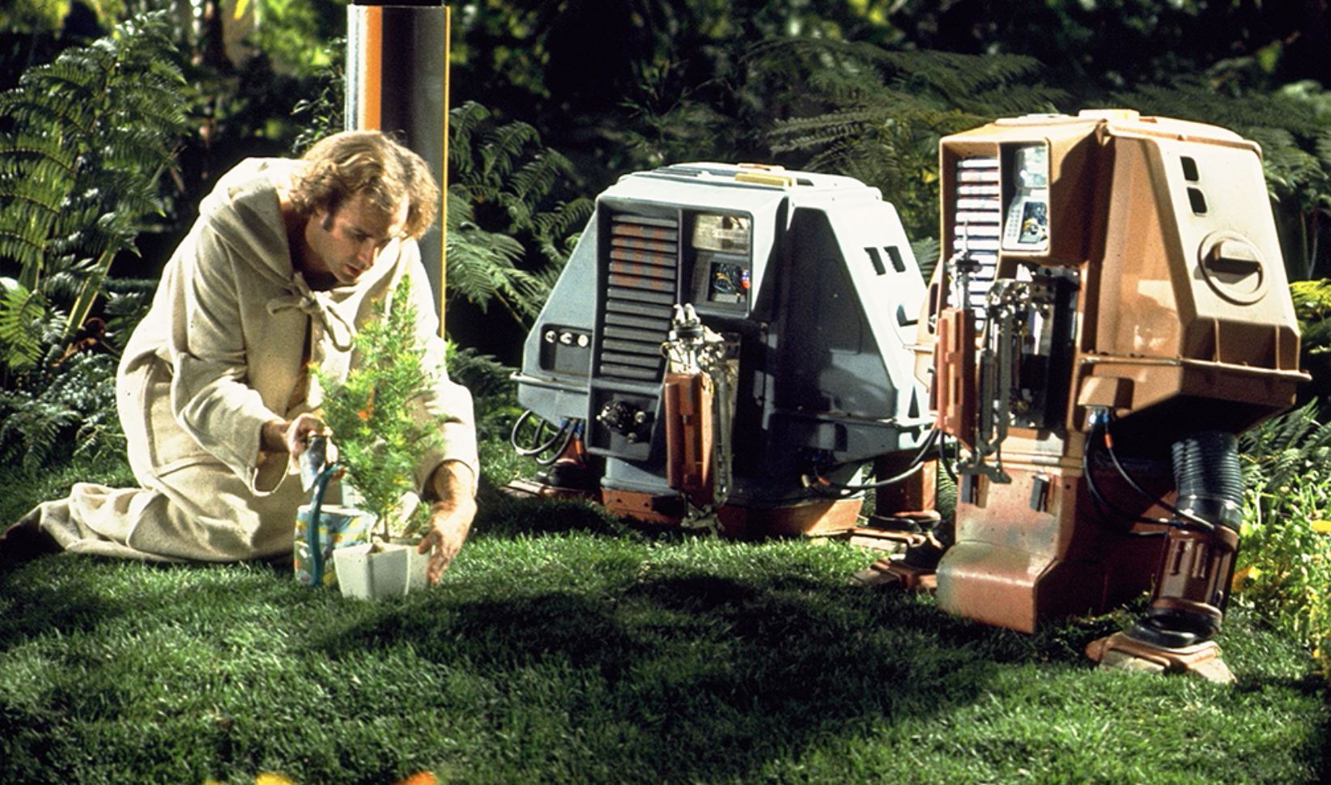
Knowledge Artifacts
Our personal knowledge artefacts are fragmented into many formats.
They are embedded into many providers: Google, Microsoft, Dropbox, Adobe, Apple
They exist in a myriad of formats, from images and PDFs to text, email, tasks, digital devices, and notes.
With Robodog, we can traverse our artefacts and convert them into a format in which a model can interact with the transformer model.

Slide 19
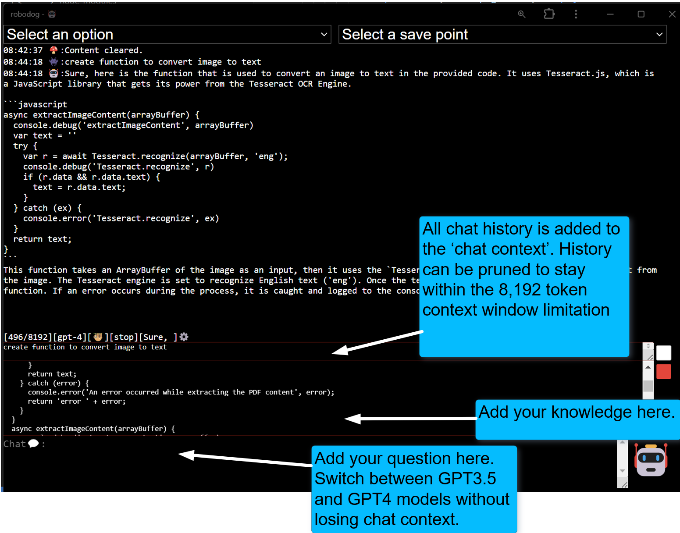
How Robodog Works

Slide 20
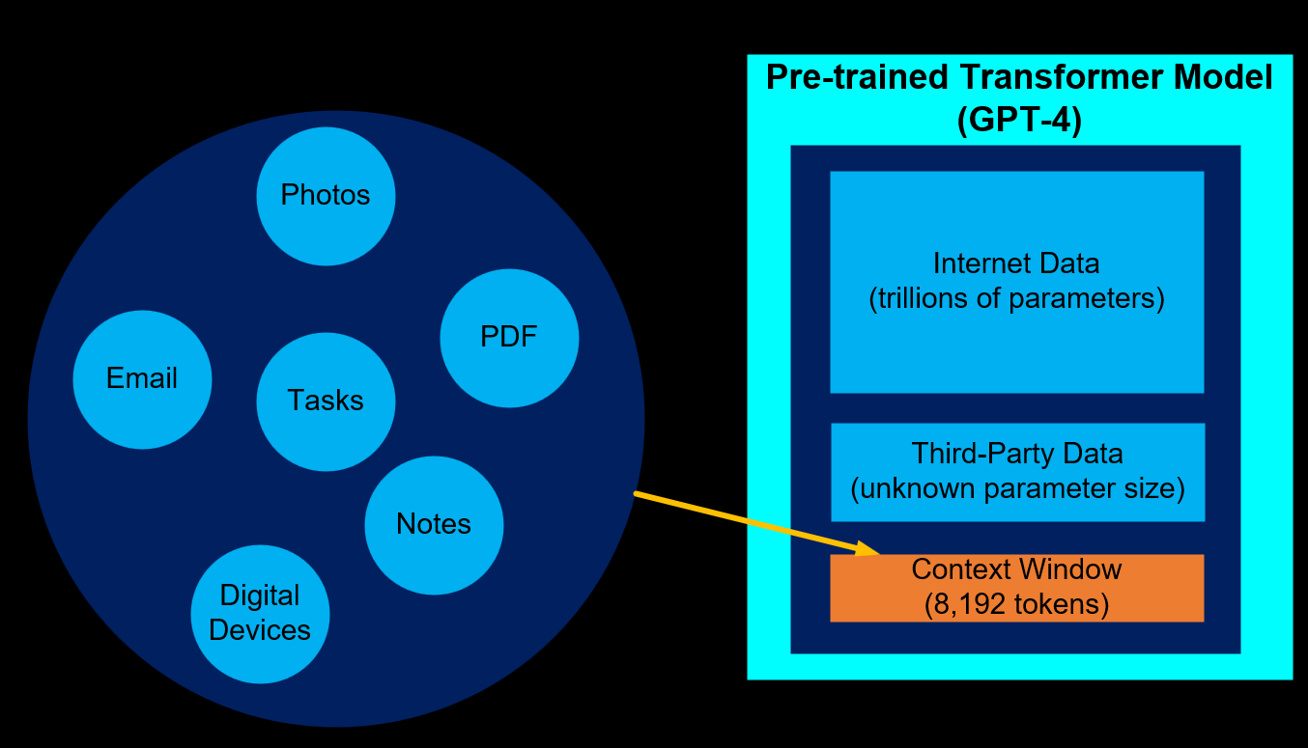
Knowledge Artifacts vs Context Window
There is no way around the limitations of the context window size.
Less expensive models are 4,000 tokens and more expensive models are 128,000 tokens
There is a need to prune the context window
The open ai custom GPT product attempts to automate pruning process using an elastic search. From experience, this does not work very well in practice

Slide 21
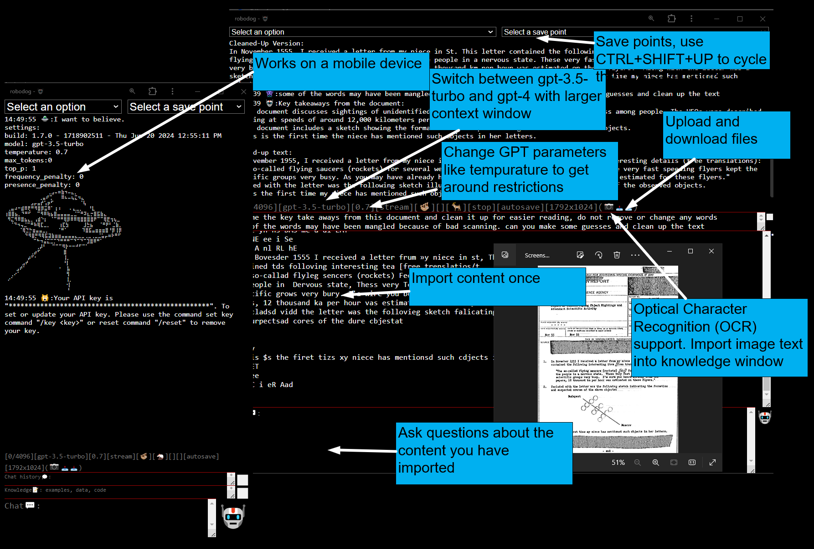
Robodog Features

Slide 22
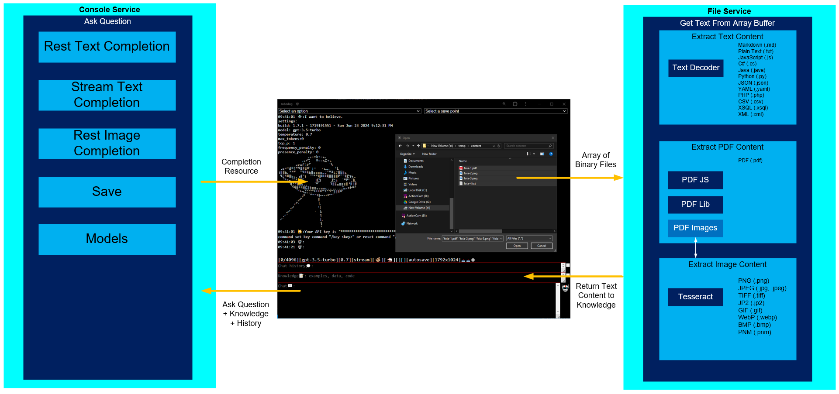
Separation of Concerns

Slide 23
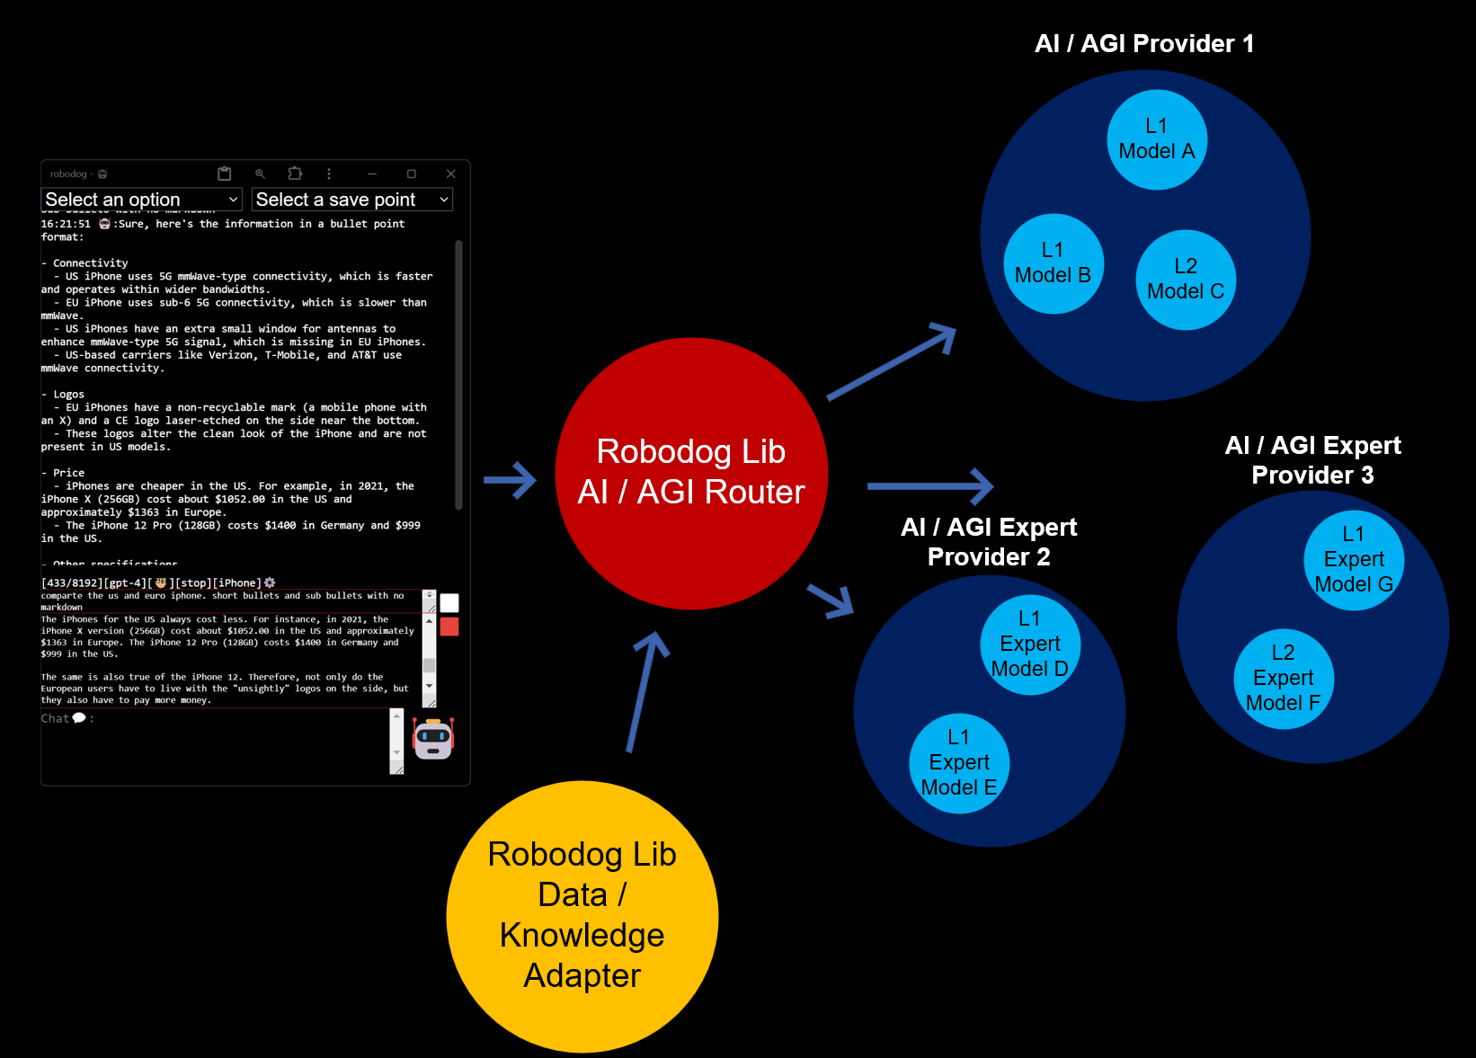

Robodog Roadmap

Slide 24
Conclusion

